Slide 1
Francis Burns UMC
Congregational Meeting

Slide 2
Spiritual Mapping
Team Members
  Teresa Holland
  Cheryl Mack Thompson
  Sharon Praylow
“Many people have set out to write accounts about the events that have been fulfilled among us. They used the eyewitness reports circulating among us from the early disciples. Having carefully investigated everything from the beginning, I also have decided to write a careful account for you, most honorable Theophilus, so you can be certain of the truth of everything you were taught.”
– Luke 1:1-4

Slide 3
Focus Group Questions
Number of letters sent to members: approx. 250
Number of members interviewed: 64
Active Membership Breakdown by Age as of May, 2018:

Slide 4
Focus Group Questions
What are our congregation's strengths?
What are our congregation's challenges?
What are the future opportunities for our congregation?
Where do you see the future of our congregation?
What previous conversations has this church had about its future?

Slide 5
Life Cycle Questions

Slide 6
Most Common Responses
What are our congregation’s strengths?
Music Department
Loving/Caring/Concerned –Most members feel at home, family atmosphere and supportive.
Missions
What are our congregation's challenges?
Children’s Programs
No Family Life Center-Safe place to hang out or have fun night
Community outreach
Communion
Failure to retain and recruit younger members
Transparency-Accountability/Financial Reporting

Slide 7
Most Common Responses
What are the future opportunities for our congregation?
Limitless
None
Goal: Making disciples
More Community Outreach
Where do you see the future of our congregation?
No future
Dying-If no changes are made.
Recognize what needs to be changed

Slide 8
Most Common Responses
What previous conversations has this church had about its future?
Only from listening to parents talk
Same conversation – More Excellent Way
Same people doing a lot of the same thing
Some members have not heard anything

Slide 9
Ministry and Identity of the Church
Team Members
  Gladys Gaillard-McBride
  Belverly Black
  Veronica Deas
“Now Jesus came into the district of Caesarea Philippi, he asked his disciples, ‘Who do people say that the Son of Man is?’ And they said, ‘Some say John the Baptist, but others Elijah, and still others Jeremiah or one of the prophets.’ He said to them, ‘But who do you say that I am?’ Simon Peter answered, ‘You are the Messiah, the Son of the Living God.’”
– Matthew 16:13-16

Slide 10
Focus Group Questions
List how your church lives out the mission statement for the UMC .
  Sermons
  Bible Studies
  Mission Efforts
    Coat Drive
    Luggage Drive
    Backpack Drive
    Thanksgiving Baskets
    Family Helping Families

Slide 11
Focus Group Questions
List how your church lives out your congregational vision statement.
Missions
Evangelism
Christian Education

Slide 12
Focus Group Questions
How are the mission and vision communicated to your congregation and the community?
Weekly Church Programs
Church Website
Banner Displays
Pastor Sermons
Lay Ministry
Bible Studies

Slide 13
Focus Group Questions
How do you understand your uniqueness as a local church? What are you known for in this community?
Music Programs/Concerts
Summer Feeding Program
Freedom School
Tutoring
Summer Work Program with the Columbia Urban League and Epworth Home

Slide 14
Focus Group Questions
List your church’s current ministries of Nurture, Outreach and witness. Nurture
Christian Adult Ministry
Children’s Ministry
Christian Education
Church School Superintendent
Higher Education Ministry
Older Adult Ministry
Worship Ministry
Youth Ministry
Music Ministry
Family Ministry (Married Couples)

Slide 15
Focus Group Questions
List your church’s current ministries of Nurture, Outreach and witness. Outreach
Health & Welfare
Missions
Status & Role of Women
Native American
Family Promise
Religion and Race
Freedom School
Interreligious Concerns

Slide 16
Focus Group Questions
List your church’s current ministries of Nurture, Outreach and witness.
Evangelism
Lay Visitation
Communications
Membership
Witness
Prayer Ministry
*Other
UMC-Women
UMC-Men
Hospitality
Archives and History

Slide 17
Focus Group Questions
How many active leaders are in the church? What is the leader’s role? 16 Active Leaders
Pastor
Lay Leader
Church Council Chair
PPRC Chair
Finance Chair
Treasurer
Trustee Chair
UMC-Women
UMC-Men
UMC-Youth
Nurture
Outreach Chair
Witness Chair
Worship Chair
Disciple Coordinator
Lay Member
Annual Conf

Slide 18
Focus Group Questions
What is the style of leadership in your church.
  The pastoral leadership style is identified as visionary which is defined as a style that is most appropriate when an organization needs a new direction. There are varied leadership styles that are exhibited by our various Lay Leaders.
Develop and attach a summary report of your average membership for each of the past 10 years. (see attached)
Develop and attach a summary report of your average worship attendance for each of the past 10 years. (see attached)
What is the current average age of your active worshipping congregation.

Slide 19
Most Common Responses
What has been significant changes in the past 10 years?
Leadership styles
Communication styles
Resistance to change
Decrease in attendance
Young adults not returning after college (no need to structure)
Pastor impact

Slide 20
Most Common Responses
Shift in community
Population and household trends
Racial ethnic trend
Age trends
School age trends
Household and family income trends
Household and children trend

Slide 21
Most Common Responses
Other issues that might impact your church’s ability to fulfill the mission of the church.
Effective communication
Lack of participation
Power struggles

Slide 22
Area of Influence and Potential for Ministry
Team Members
  Rev. James Friday
  Dr. Martin Quick
“Do you not say, ‘Four months more, then comes the harvest’? But I tell you, look around you and see how the fields are ripe for harvesting.”
– John 4:35

Slide 23

INFORMATION SOURCE

Slide 24
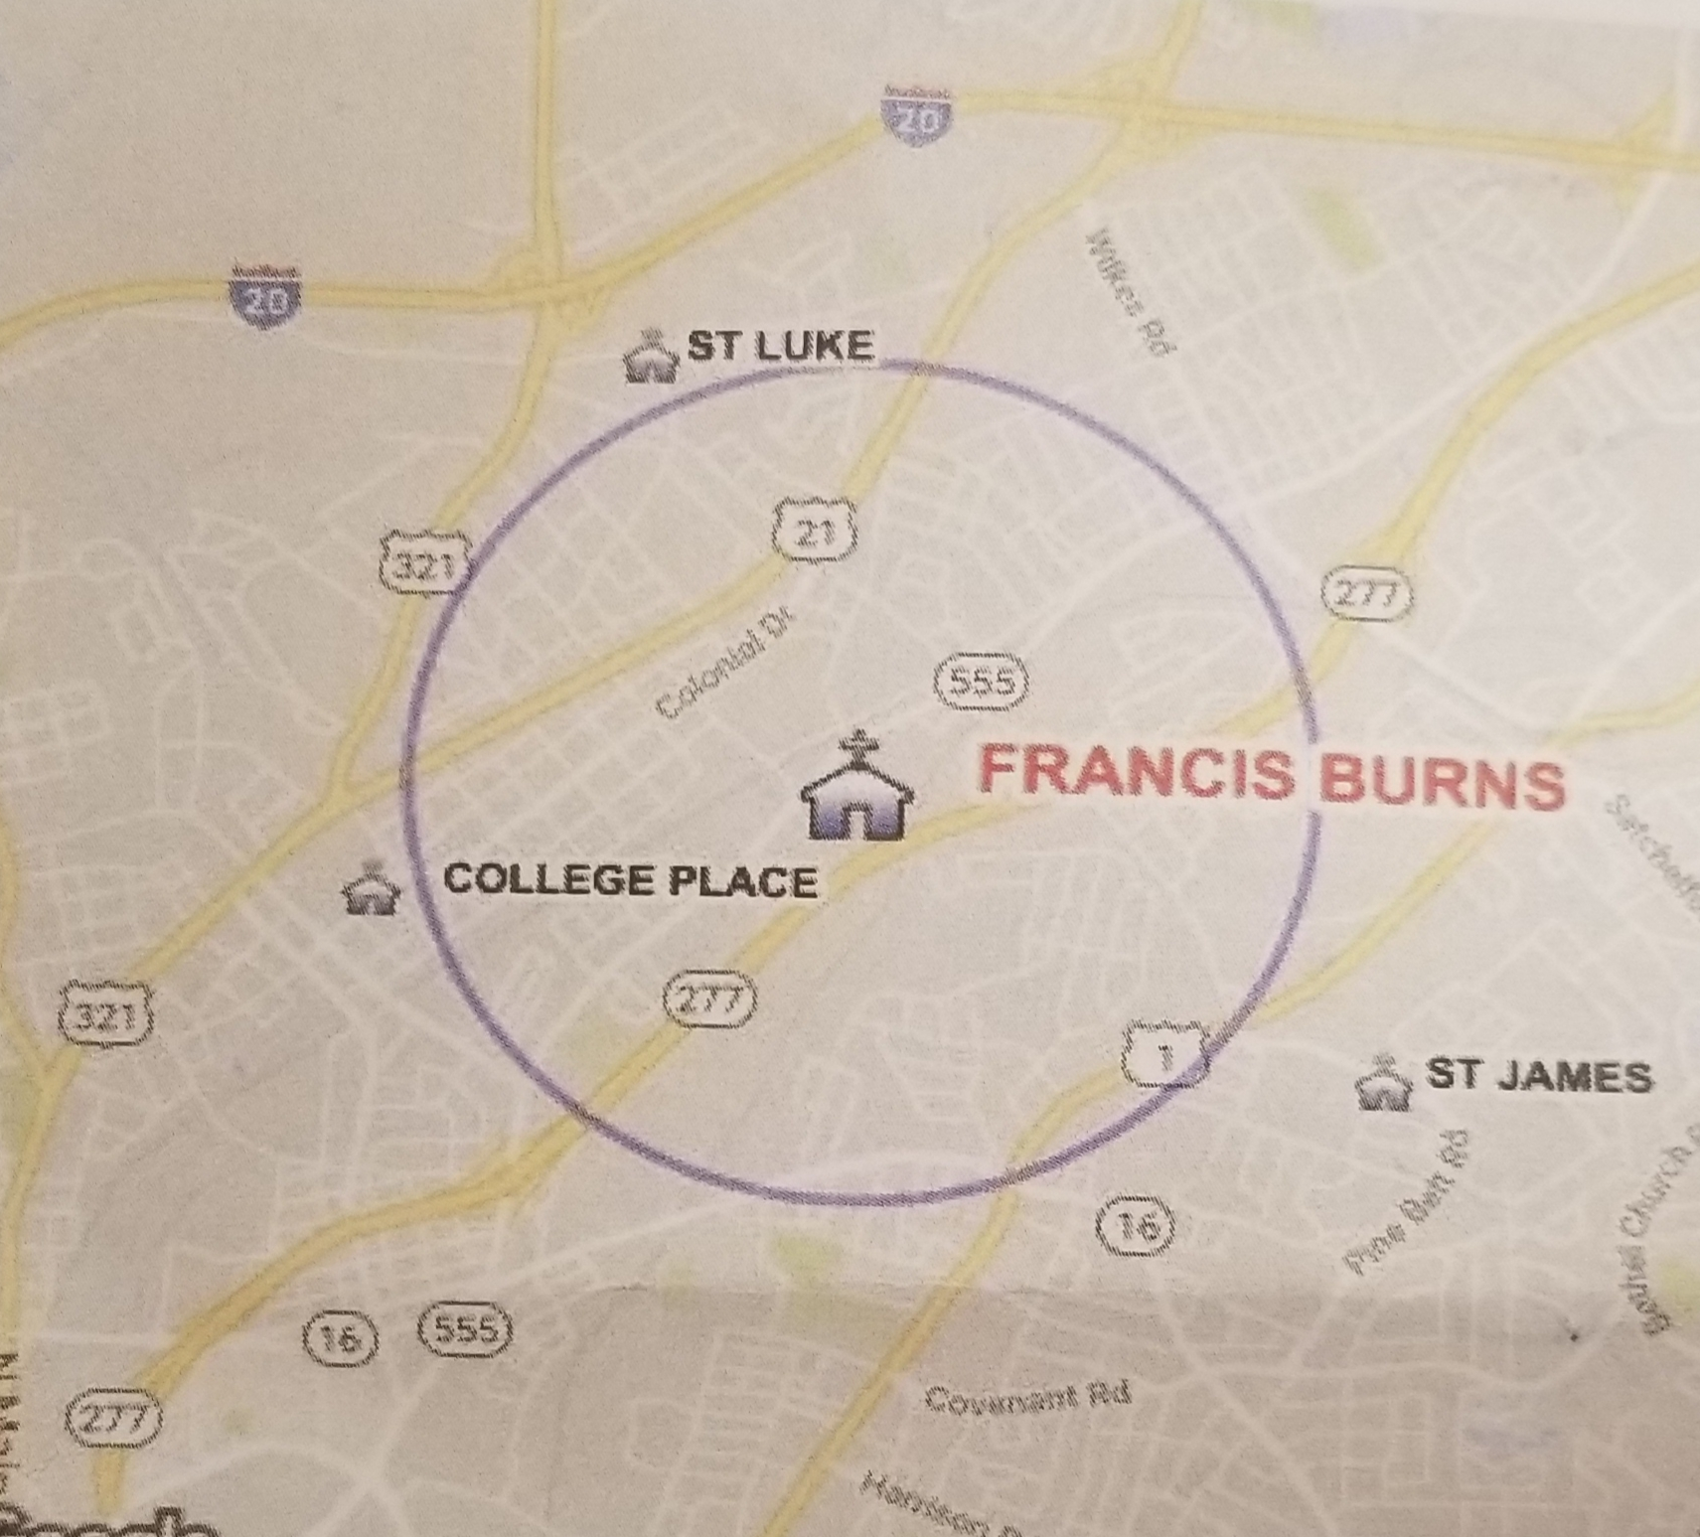
TRAVEL POLYGON
10 MINUTE WALK 7 MINUTE DRIVE

Slide 25
OTHER UMC CHURCHES
St. Mark
College Place
Rehoboth
St. James
I Dequincy Newman

Slide 26
Non-UMC Churches
Greenview Baptist Greater St. Luke Baptist
Bethlehem Baptist Reid Chapel AME
Northminster Presbyterian Gill Creek Baptist
Second Nazareth Baptist New St. Thomas Episcopal
Church of Christ Disciples of Christ
Muhammad’s Mosque #37

Slide 27
FYI
School District Richland 1
85% of the students are on free or reduced lunch

Slide 28
Community Organizations
Food banks: Harvest Hope, Cooperative Ministry
Treatment Centers: LRADAC, Columbia Metro Treatment Center, Crossroads Treatment Center, Prevention Resource Center
Homeless Shelters: Family Shelter, Transitions Homeless Center, St. Lawrence, Woman’s Shelter, Providence Home, Hannah House
Youth Centers: Hyatt Park Recreation, Meadow Lake Park Recreation, MIRCI Youth Drop-in Center, A Youth Center, Harriet Hancock LGBT Center, Big Brothers Big Sisters
Retirement Communities: Brookdale Columbia, Laurel Crest, Atria Forest Lake, Walters Retirement Home, Rice Home, Reese’s Community Care Home, Pruitt Health, C M Tucker Jr., Walter’s Residential Care.

Slide 29
Surrounding Neighborhoods
Capital Heights Highland Park
North 21 Terrace Farrow Hills
New Castle Ames Manor
Greenview Hollywood Hills
Meadow lake English Manor
Prescott Terrace

Slide 30
Missional Opportunities
Food Desert: places to purchase fresh fruit and vegetables
Community Family Center
Businesses that contribute to the tax base
Pre-school and daycare center
Job training
Wi-Fi and Computer Access

Slide 31
Growth Potential
8,623 people in a 1 mile radius
78,023 in a 3 mile radius
2023 1 family increase
90.3 % African American

